Slide 1
Reading travel graphs
Miss L
Year 7

Slide 2
Learning Intentions
Students will be able to
Interpret a travel graph

Slide 3

Quick-write
You have 2 minutes to tell me how you got to school today…..
  Include any stops like picking up a friend.
  How long did it take you to get to school?
WICOR

Slide 4
So the information that you have just written down, how can we display it?
  Can we put it into a graph?

Slide 5
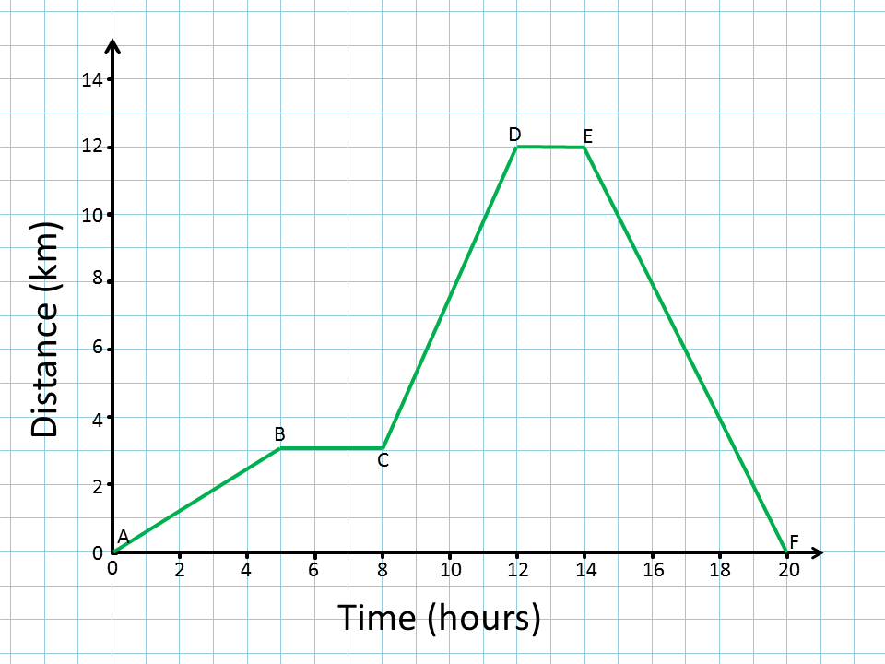
24
7
30
Topic: Travel Graphs
Date:
EQ – How do we read travel graphs?
What is a distance-time graph?
A graph that compares the time and distance
Features of a Time-Distance Graph:
  Time is the independent variable so Time is marked on the horizontal x-axis.
  Distance is the dependent variable so Distance is marked on the vertical y-axis

Slide 6
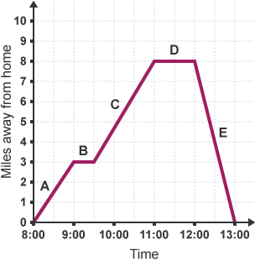
Stopping
Going home
Traveling
Leaves home

Slide 7


Slide 8
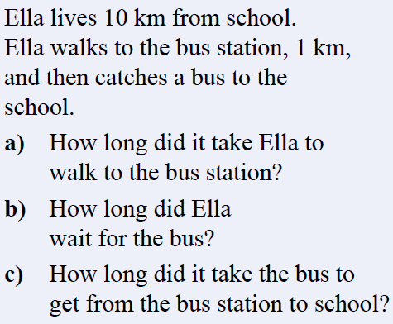
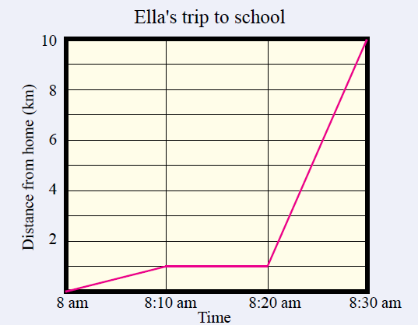
Practice
10 minutes
b) 10 minutes
c) 10 minutes
Notes:
Guide students through the question.
Option 2: Dot plots handout (Scaffolded for kids who may need extra help)

Slide 9

Practice
How do we calculate speed???
Notes:
Guide students through the question.
Option 2: Dot plots handout (Scaffolded for kids who may need extra help)

Slide 10
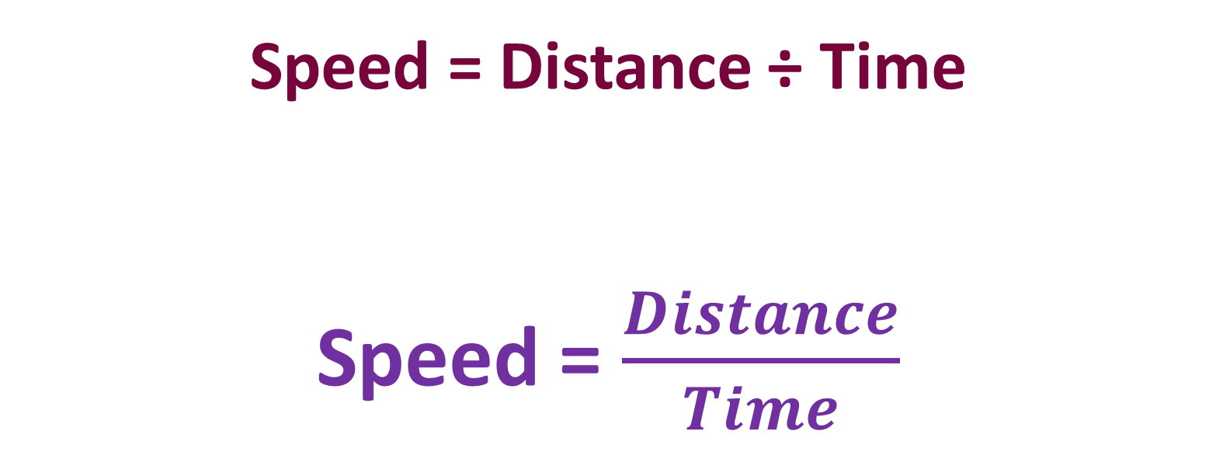
Calculating Speed
Speed = Distance ÷ Time
Speed = $\frac{Distance}{Time}$

Slide 11
Practice
d) Speed = distance ÷ time
Distance = 9 km
Time = 10min
9km ÷ 10 min = 0.9km per min
Notes:
Guide students through the question.
Option 2: Dot plots handout (Scaffolded for kids who may need extra help)

Slide 12
Practice
e) Speed = distance ÷ time
Distance = 1 km
Time = 10 min
1 km ÷ 10 min = 0.1km per min
Notes:
Guide students through the question.
Option 2: Dot plots handout (Scaffolded for kids who may need extra help)

Slide 13
Task
Complete Worksheet
Complete Summary
Notes:
Guide students through the question.
Option 2: Dot plots handout (Scaffolded for kids who may need extra help)

